Slide 1
Advanced big data analytics project
Kowshik Raj Durai Murugan – KXD180034

Slide 2
BUILDING A Streaming data pipeline USING APACHE HADOOP, SCALA and KAFKA on DOCKER
In many data centers, different type of servers generate large amount of data (basically events, where ‘event’ in this case is the status of the server in the data center) in real-time.
There is always a need to process these data in real-time and generate insights which will be used by the server/data center monitoring personnel. Also, they have to track these servers’ status regularly and find the resolution in case of issues for better server stability.
Since the incoming data is huge and in real-time, the right architecture with scalable storage and computation is required.

Slide 3
PIPELINE ARCHITECTURE
Single Node Hadoop & Spark cluster on Docker
Data Source Layer (Simulator) – Python program
Messaging Layer – Apache Kafka
Data Processing Layer – Spark Structured Streaming & PostgreSQL
Data Visualization Layer (Dashboard) – Django Web Framework & Flexmonster (trial)

Slide 4
INITIAL SETUP
First I run the below command to create a custom network,
docker network create --subnet=186.20.0.0/16 datamakingnet12
Initially to get Kafka and Zookeeper up and running on our system, I run the following commands,
docker run -d --hostname zookeepernode --net datamakingnet12 --ip 186.20.1.3 --name datamaking_zookeeper --publish 2181:2181 zookeeper:3.4
docker run -d --hostname kafkanode --net datamakingnet12 --ip 186.20.1.4 --name datamaking_kafka --publish 9092:9092 --publish 7203:7203 --env KAFKA_ADVERTISED_HOST_NAME=192.168.99.100 --env ZOOKEEPER_IP=192.168.99.100 ches/kafka

Slide 5
Creating Hadoop & spark cluster on docker
First, I run the below command to create set of docker images for Apache Hadoop, Apache Spark, Apache Hive and PostgreSQL,
./1_create_hadoop_spark_image.sh
Next, I run the below command to create set of containers for Apache Hadoop, Apache Spark, Apache Hive and PostgreSQL to build a Create Single Node Hadoop Spark Cluster
./2_create_hadoop_spark_cluster.sh create

Slide 6
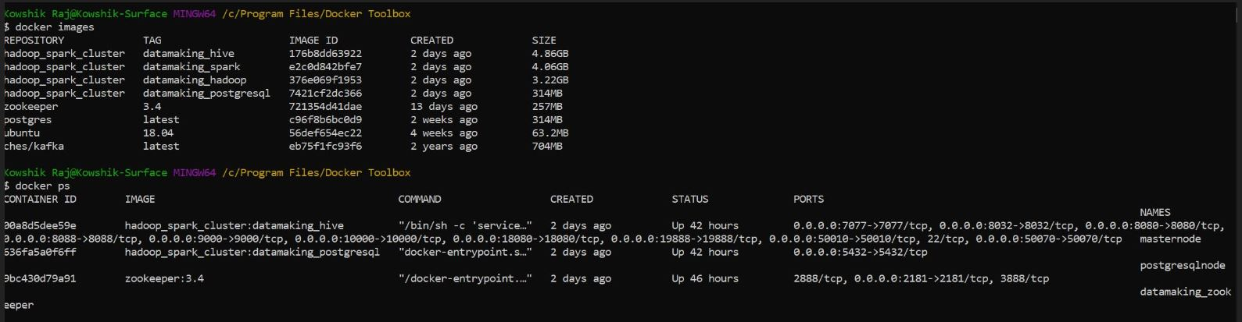
The below screenshot displays the images created and the various containers running to support
Kafka, Zookeeper, Hadoop, Hive, Spark and PostgreSQL for the next steps in the project.

Slide 7
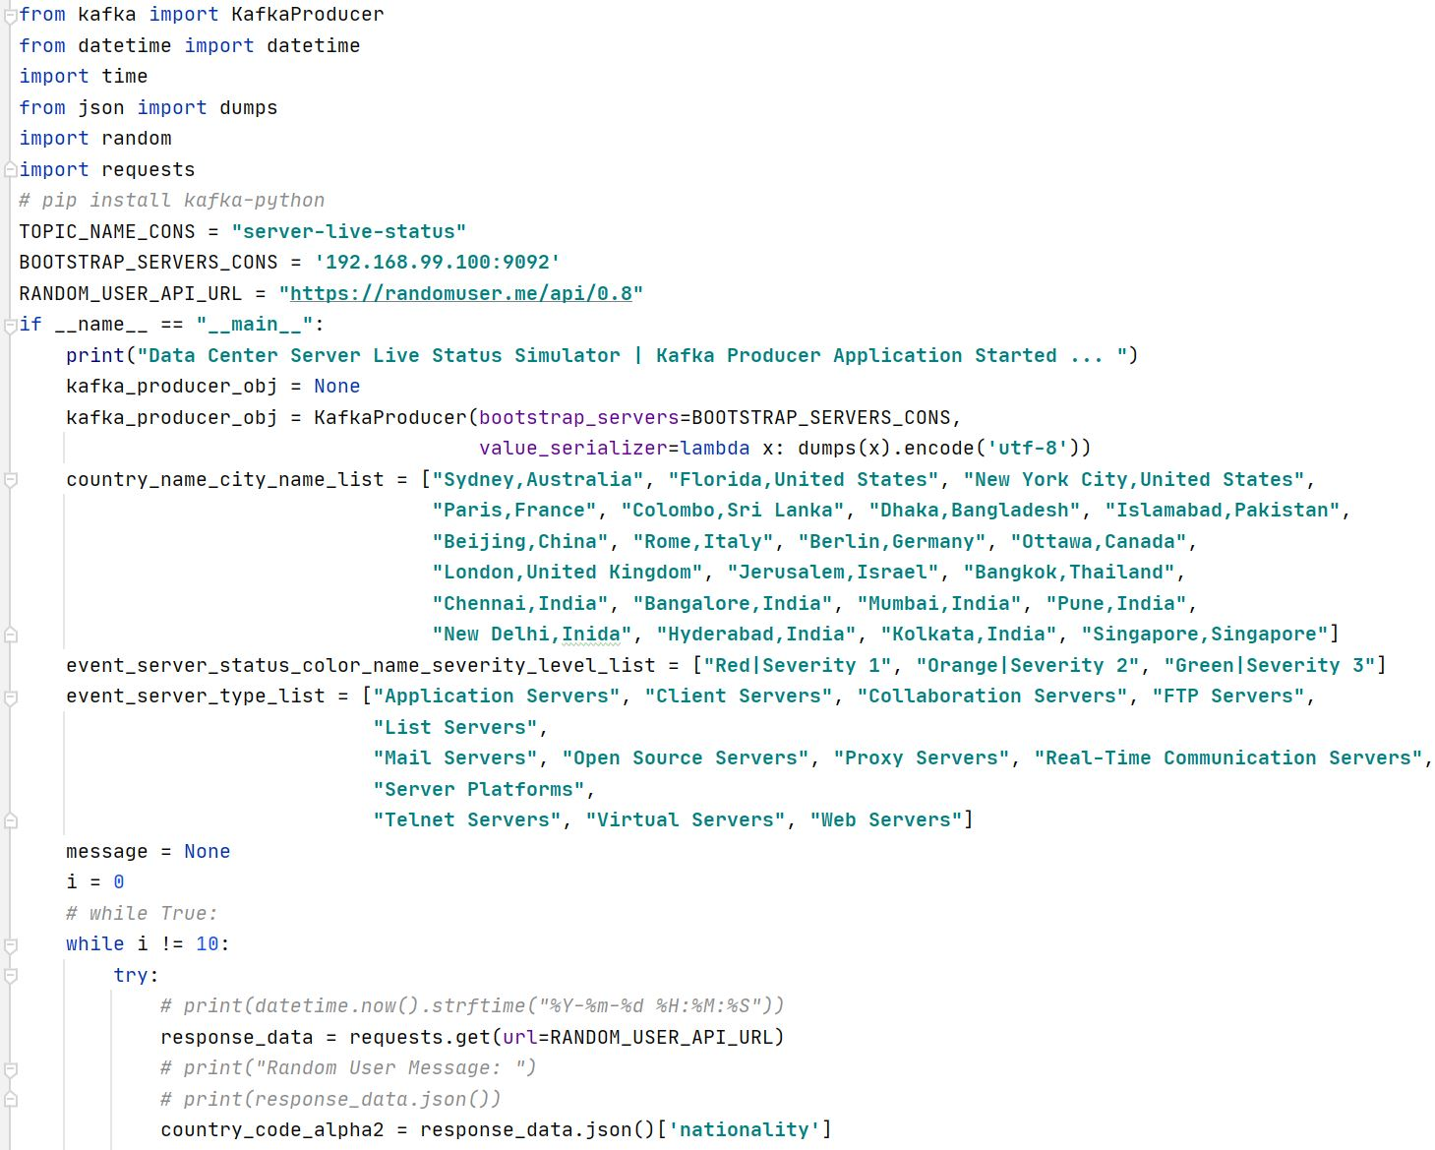
CREATING THE Data source layer using python
The image on the right shows a snippet of the Python program used to simulate the events (i.e.) live status of servers and send the messages to the Kafka topic which is basically the messaging layer.
The messages are sent as JSON strings with random countries and random numbers. The countries are extracted from random users’ information generated using an API as specified in the code:
https://randomuser.me/api/0.8

Slide 8
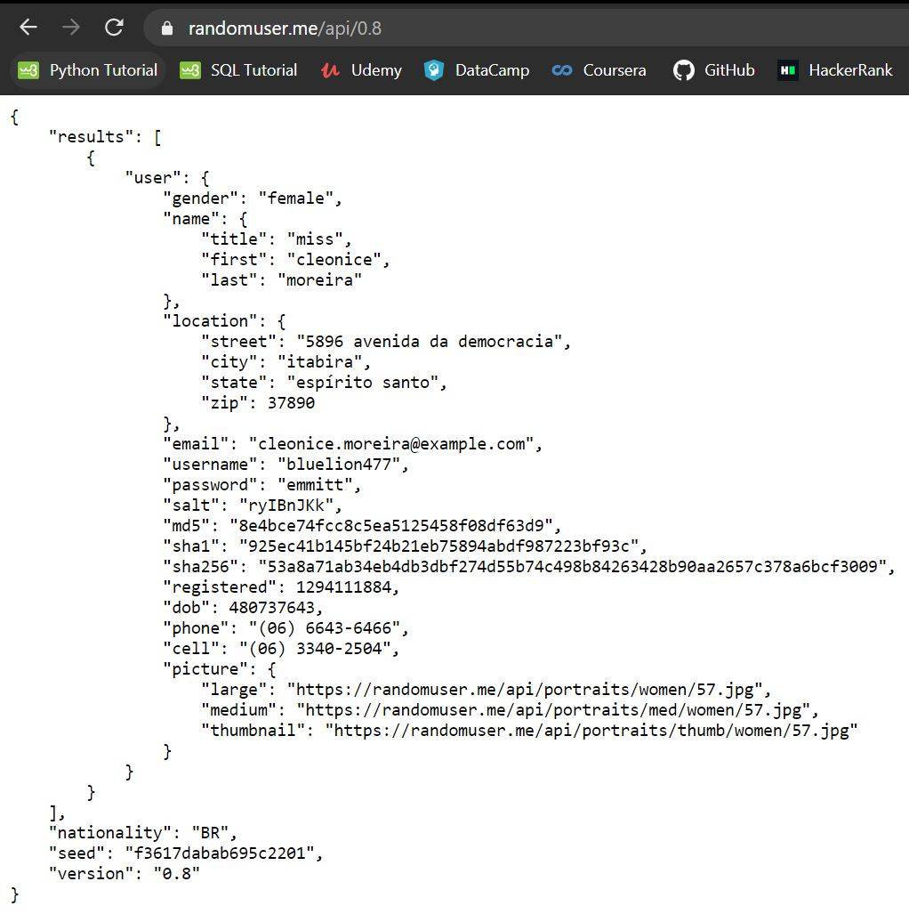
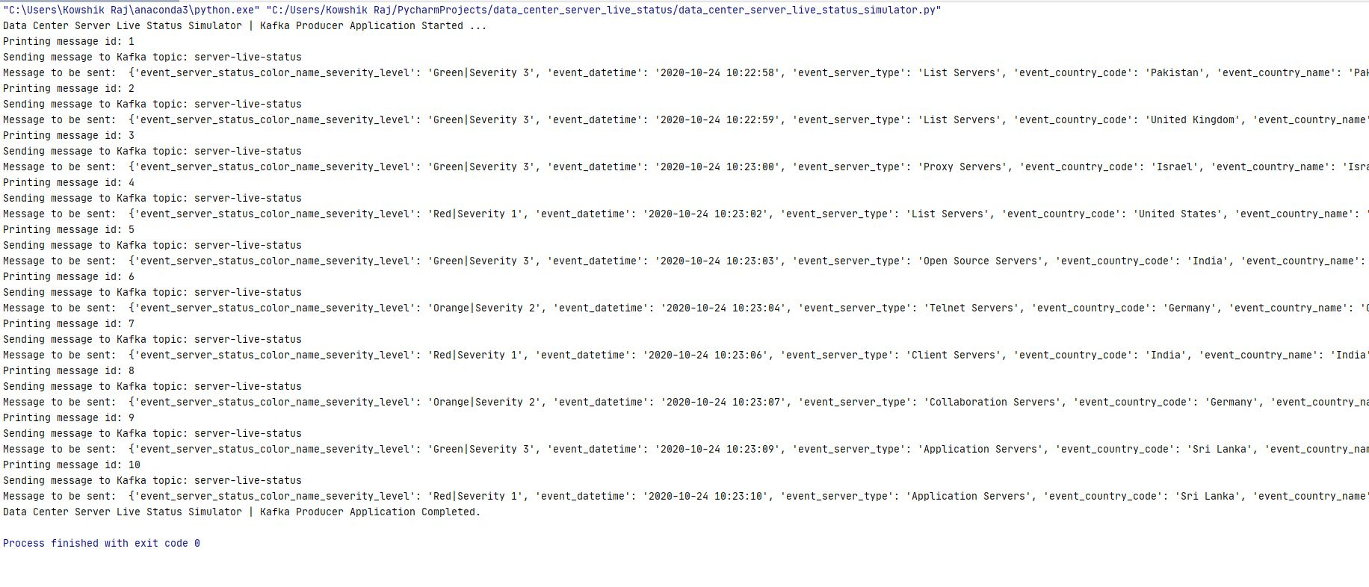
API showing random user information
generated
The above screenshot shows 10 random messages generated which are then published to the Kafka topic every 1 second using the ‘kafka producer object’

Slide 9
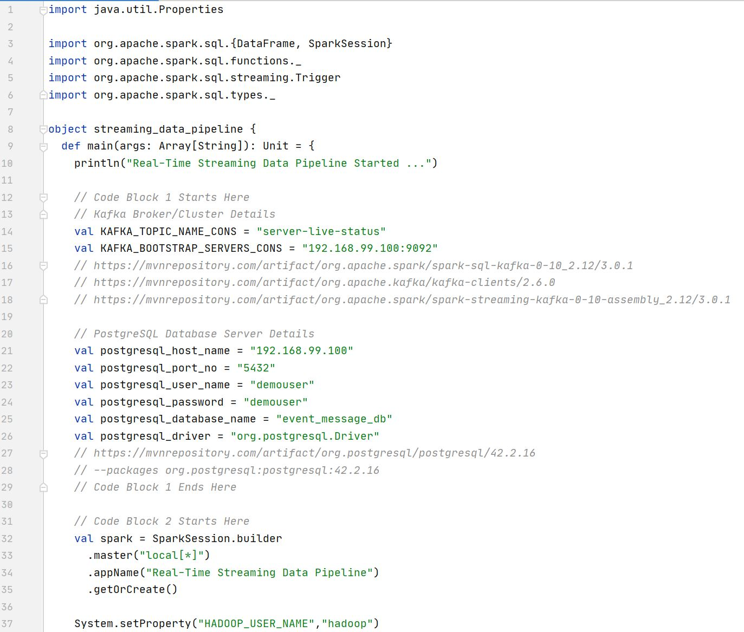
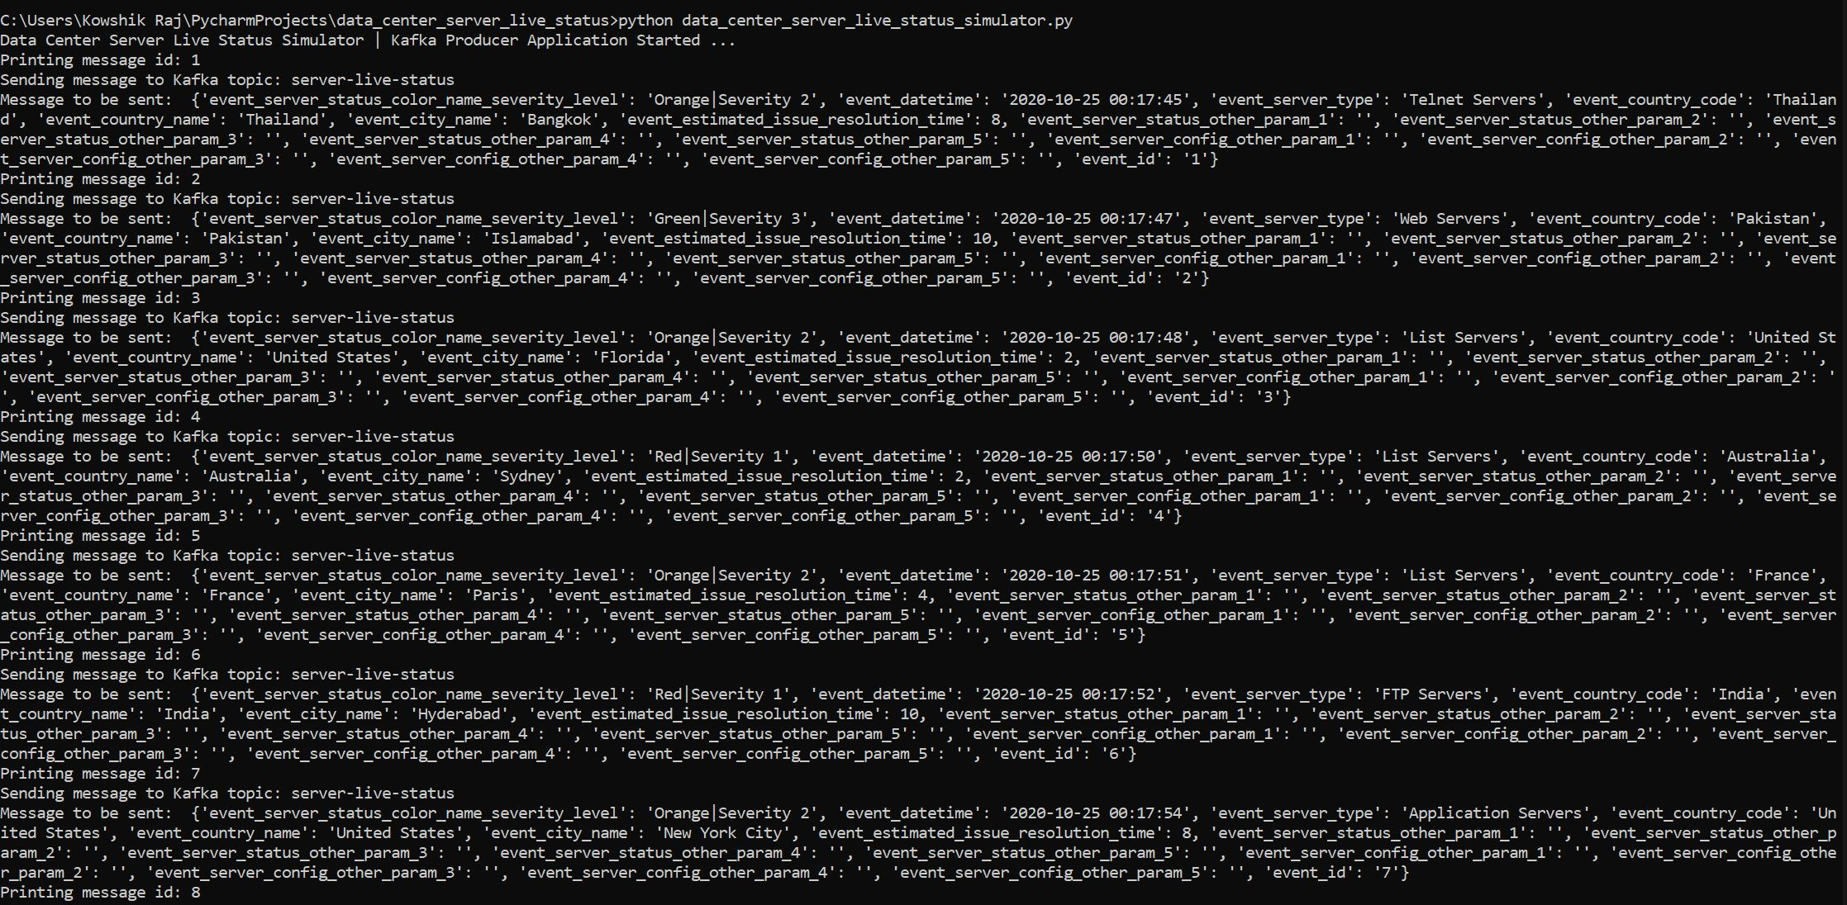
CREATING THE streaming DATA PIPELINE USING SCALA ON intellij
First, we run the python simulator program (shown
below) to publish messages to the Kafka topic so
that the streaming pipeline will consume these
messages and perform the necessary
transformations and aggregation (shown right).

Slide 10
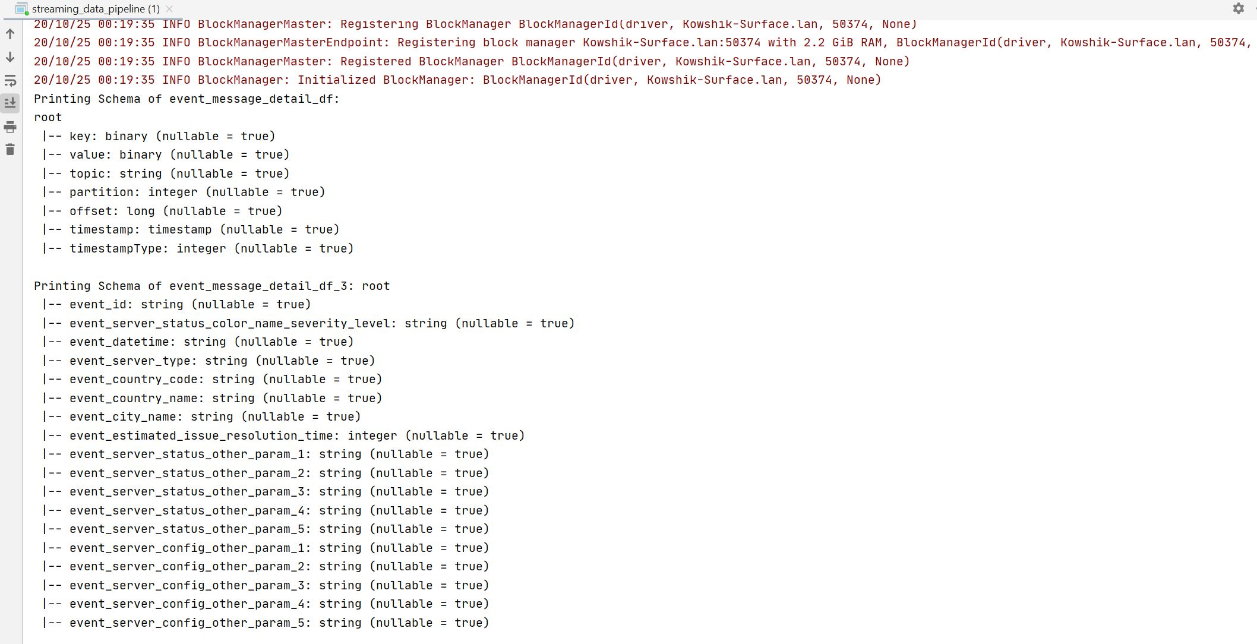
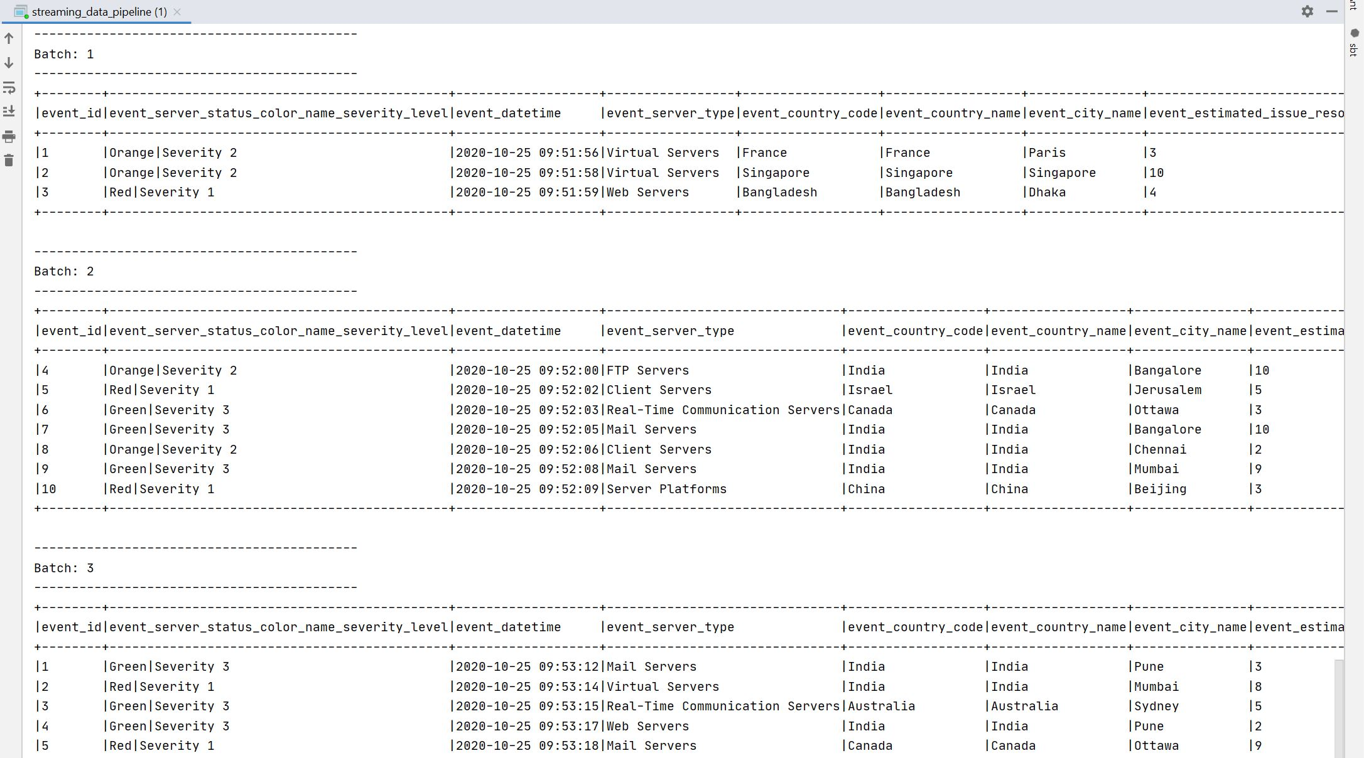
RESULTS OF RUNNING THE DATA PIPELINE
Initially, the program displays the schema of the
messages being displayed
The above screenshot shows the aggregated results
for batches of messages published to the Kafka topic

Slide 11
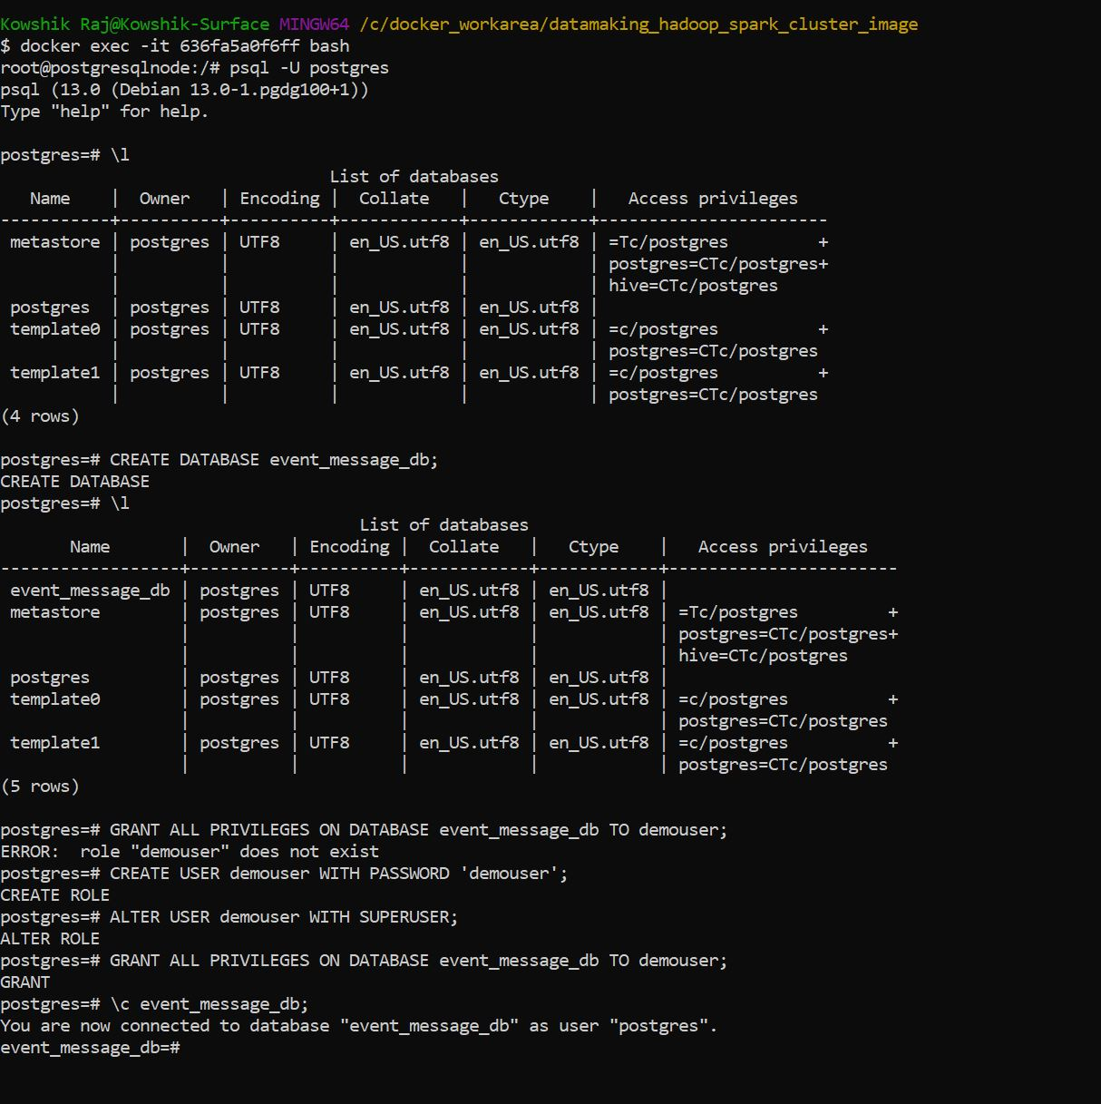
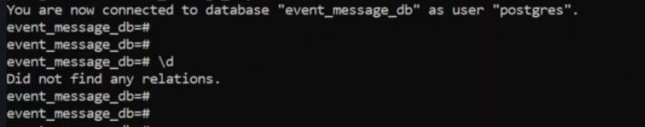
SETTING UP THE EVENTS DATABASE USING POSTGRESQL
First, to make use of the container for PostgreSQL, we use
the command docker exec –it <<container-id>> bash (shown
right). Once in, we login to the database by creating a user and
granting all privileges.
Following this, I create a database called ‘event_message_db’
and grant the user created all privileges to edit the database.
As expected, upon executing any query on the database, no
results are generated as shown below,

Slide 12
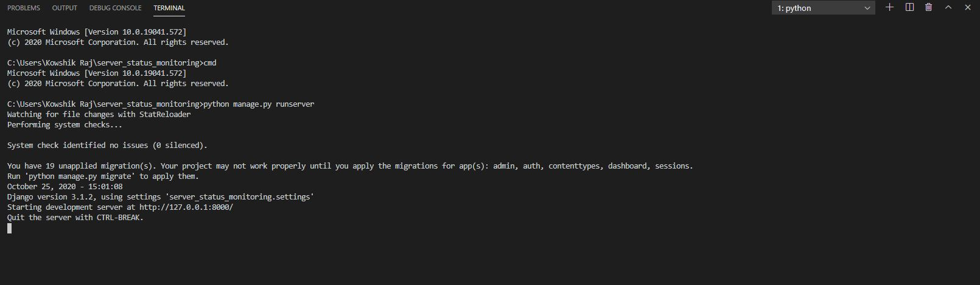
BUILDING THE DASHBOARD USING DJANGO AND FLEXMONSTER
On Visual Studio Code, I run manage.py program which manages the files and applications such as
Flexmonster (package in the Django web framework) required to setup the dashboard

Slide 13
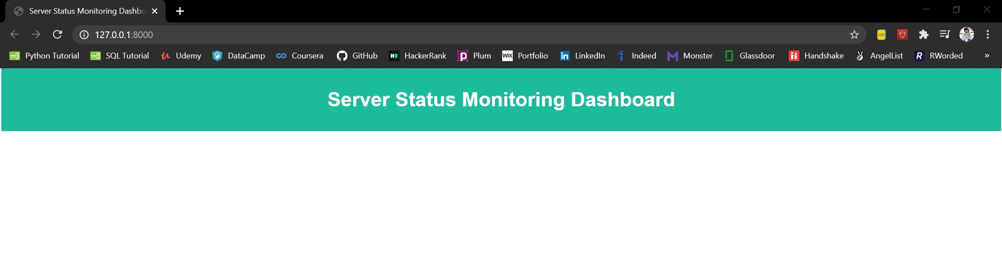
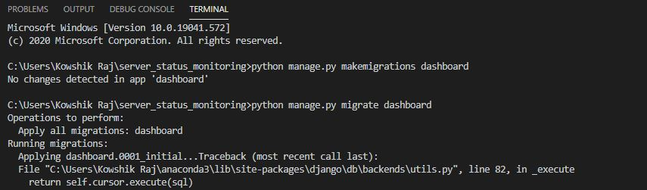
After running manage.py, when we
view the development server
(http://127.0.0.1:8000/) on which
our dashboard gets published we
observe that it is empty as there are no
event messages to be populated with.
Prior to starting the simulator and running
the data pipeline, I grant permissions for
the data to be migrated and published
on the dashboard.

Slide 14
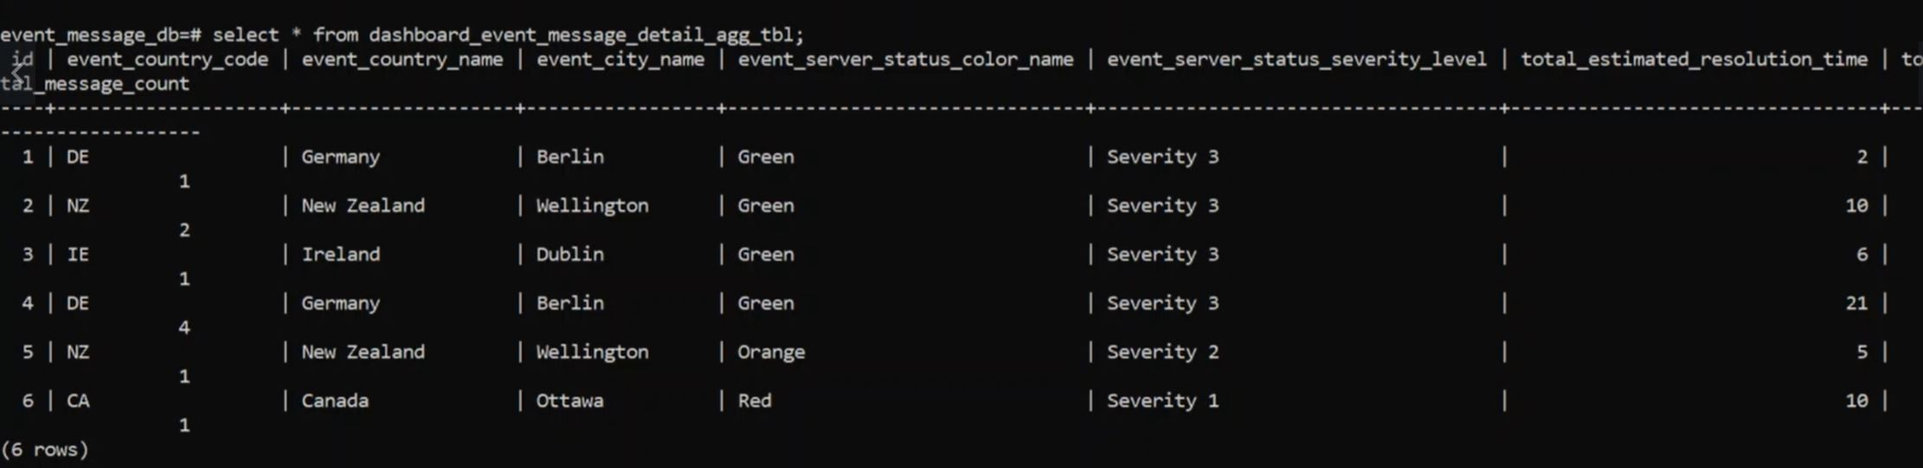
FINAL RESULTS
Once the simulator starts running and publishing messages to the Kafka topic and the data pipeline
aggregates the results, running a ‘SELECT *’ query on the events database yields the below sample result,

Slide 15
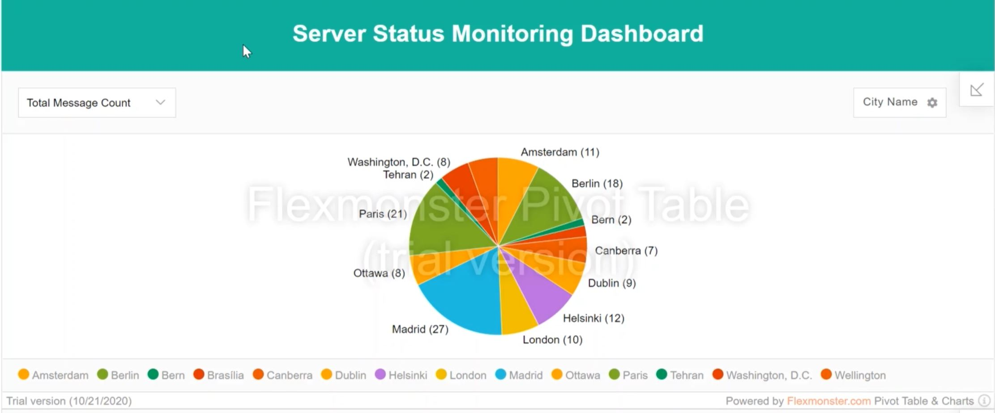
FINAL results (contd…)
Now, upon refreshing the dashboard server as the data pipeline aggregates the results, it gets
Populated with various visualizations about the server status which were previously JSON strings
Making it more appealing and enabling effective story-telling.

Slide 16
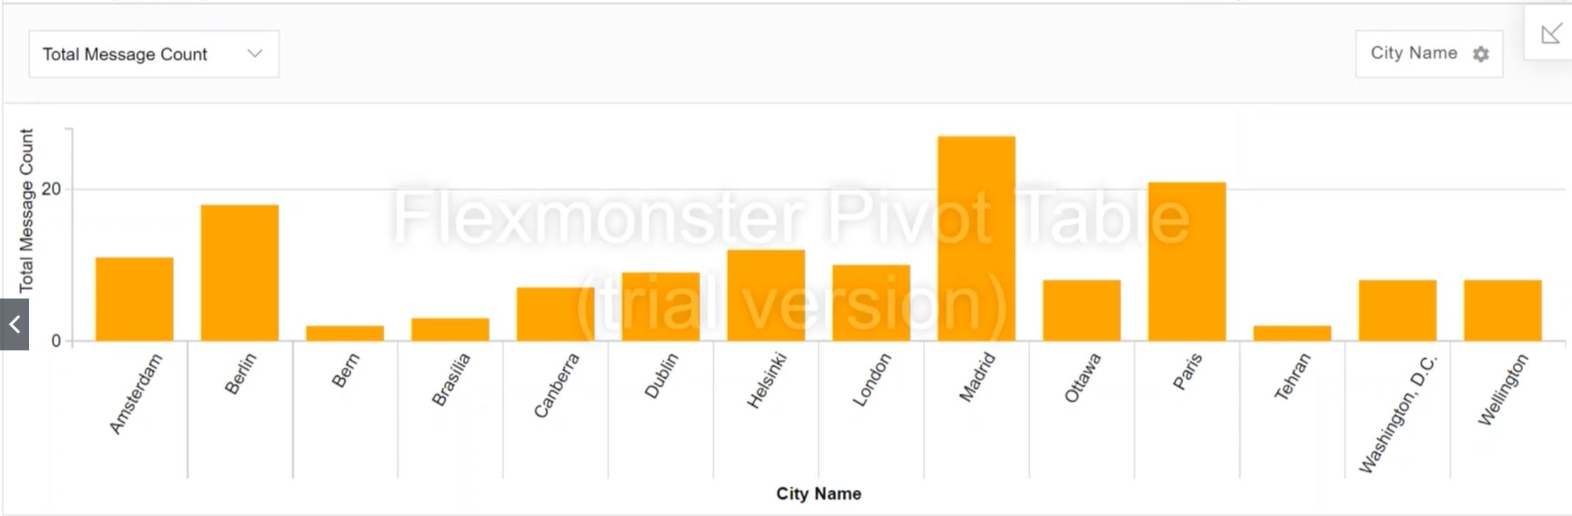
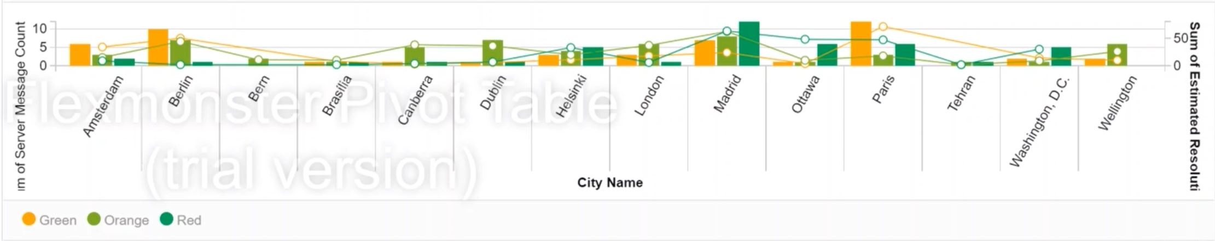
FINAL RESULTS (CONTD…)

Slide 17
REFERENCES
https://github.com/indiacloudtv/pyspark_structured_streaming/tree/main/kafka_producer_consumer
https://kafka.apache.org/documentation/#producerapi
https://github.com/flexmonster/pivot-django
https://hub.docker.com/_/postgres

